Slide 1



ACTIVATE
Milestones
WADHWANI FOUNDATION | Entrepreneur
01

Slide 2


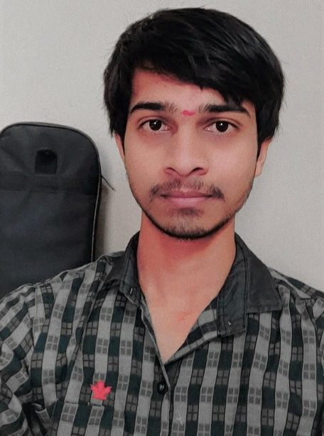
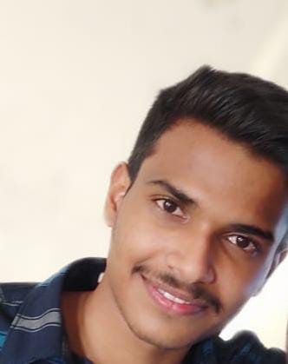
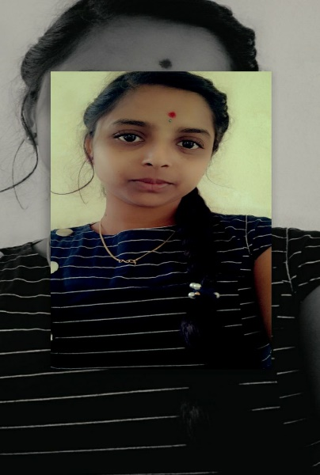
INTRODUCTION AND TEAM COMPOSITION
WADHWANI FOUNDATION | Entrepreneur
Business Name: ! DO KNOW
PV ID:
Team members names | Strengths and abilities | Role/Position
Tarun Kotagiri | Growth mindset, Confident. | CEO
G. Vivek | Strategic planning, Innovative thinking, | COO/CTO
P. Sushma | Hard working, Quick learning | CFO/CMO
What makes us a good team to solve the problem we chose?
We share a common goal of improving the education style and making an impact on the STUDENT life. All of us work hard towards our aligned goal, we offer each other support, we communicate well with each other, We have fun working together.
Each of our team mates a variety of skill sets. Tarun is a 3d designer, Ethical hacker, great programmer with a lot of technical experience. Vivek is greatly dedicated to his work . Come rain or shine ,Vivek finishes any task . Sushma is good with her communicational skills. She has good connectivity with people. Hence, our team is good to solve the problem we chose.
TARUN VIVEK SUSHMA
02
Creating Jobs. Changing Lives.

Slide 3


PROBLEM STATEMENT CANVAS
WADHWANI FOUNDATION | Entrepreneur
PROBLEM STATEMENT: Difficulty in visualization of Academic concepts.
Though lot of students attain classes regularly, many of them find difficulty in understanding the concepts. Many factors can effect the conceptual understanding of a student. Being not able to visualize the concepts perfectly is one such main factor. It causes bad impact on student’s Conceptual understanding. Students lose interest in learning too.
Good visualization improves understanding, gives clarity, enhances attention for every student.
Most of the students use online platforms like YouTube,BYJUS, Khan Academy and other academic platforms to understand the concepts. Most of the content are either written or
2-dimensional.This is one main drawback of the online platforms in not being able to provide clarity in concepts to all students.
02
Creating Jobs. Changing Lives.

Slide 4


CUSTOMER
WADHWANI FOUNDATION | Entrepreneur
Place your
Results
What is your Market type? | B2C
What is your TAM - Total Addressable Market? | 601 million students
What is your SAM – Serviceable Addressable Market? | 949000 students
What is your SOM – Serviceable Obtainable Market? | 120000 students
What is your Niche? | B-tech students of Hyderabad.
02
Creating Jobs. Changing Lives.

Slide 5
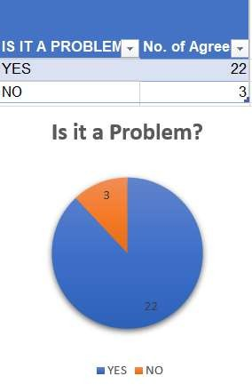
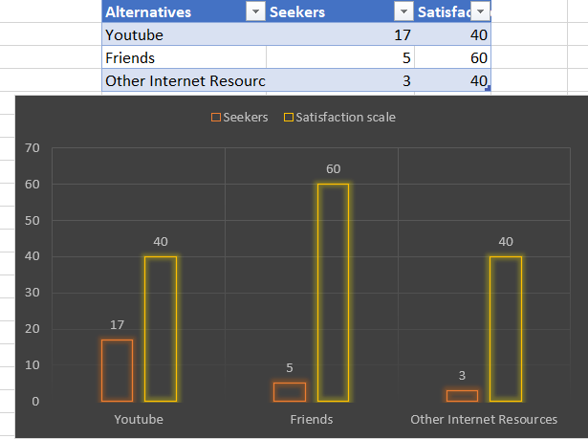


RESULTS OF THE SURVEY:
WADHWANI FOUNDATION | Entrepreneur
https://docs.google.com/spreadsheets/d/1djKbqE3K7Ztrs5pyBlZ5pT7ORl8xAgyH7xftgP
Results
How many customers did you interview? (At least 25 for B2C and 2 for B2B) B2C - 25
How many of them agree this is a problem that needs to be solved? 22
How many of them said they can already solve this problem and don't need a new solution? 3

Slide 6
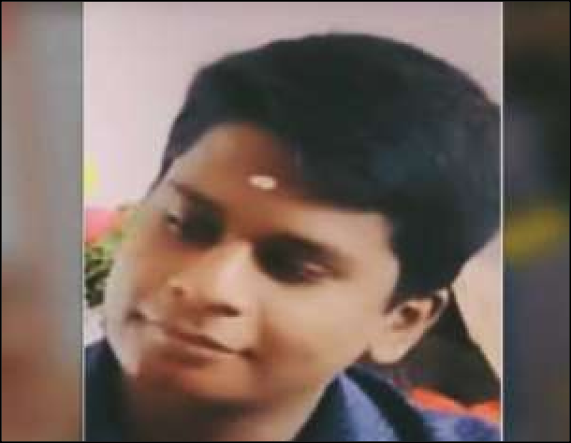

CUSTOMER PERSONA (PRESENT CUSTOMER PERSONA FOR ALL CUSTOMER SEGMENTS)
WADHWANI FOUNDATION | Entrepreneur
Goals:
*To complete his graduation without any backlogs.
*To get placed in an MNC.
Frustrations:
*Unable to understand all the academic concepts
*Unable to clear all the subjects in the semester exams
Goals
• ?
• ?
• ?
• ? Frustrations
• ?
• ?
• ?
“I’m a determined and enthusiastic person”
Motivations
His family and friends are constant motivation to Thanuj
Age (in years):20 Gender: Male
Profession: Student
Personality
Bio
Thanuj is a young and enthusiastic student studying computer science in KGR. He loves to watch movies and play cricket. He aims to be placed in a MNC and have good salary to lead his family. He attends all the classes regularly yet find it difficult to understand the topics from his syllabus due to lack of concept visualization. He uses YouTube to understand the concepts but still not satisfied with it.
Joyful, hard-working and honest.
Creating Jobs. Changing
Lives.

Slide 7

WADHWANI FOUNDATION | Entrepreneur
You have created a product or a service that add value to a defined set of customers and solve the problems you defined in the first phase.
You learnt about MVPs and you know their importance.
You have built an MVP, with consumption of minimal resources and tested your theory in less than 3 weeks.
You have conducted competitive analysis and the product/service developed has unique properties.
You distinguished early adopters and interviewed user for
data collection and concept validation.
You have validated your concept or started revamping based on your data analysis.
MILESTONE 2: DISCOVER
03
Creating Jobs. Changing Lives.

Slide 8

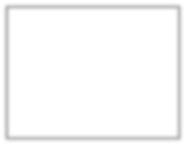

VALUE PROPOSITION CANVAS
WADHWANI FOUNDATION | Entrepreneur
Place your logo here
→What do you offer that makes the customers happy?
We offer our customers i.e students clear visualization academic experiences.
I would LOVE it if:
→? What would make the customer happy?
Clear visualization of academic concepts
→? What do the clients want when facing the problem?
Real life experience of the academic concepts
What is the product or service that you are offering?
VIRTUAL REALITY online platform with an access to students academic concepts.
I would WANT:
→What do the clients do (actions) when facing the problem?
Try to understand the academic concepts with the help of online academic platforms or their friends.
GAIN CREATORS
GAINS
PRODUCT/ SERVICE
JOBS
PAIN KILLERS
PAINS
→Which features of your offering relieve the customer's pains?
Using virtual reality to learn academic concepts help students understand complex concepts and remember for a long time.
I would HATE it if:
→What are the pains of the clients when facing the problem?
-Unable to understand academic concepts
-Unable to remember the academic concepts
02
Creating Jobs. Changing Lives.

Slide 9


COMPETITION ANALYSIS
Place your PV
logo here
 | IMMERSIVE VR EDUCATION | UNIMERSIV | KHAN ACADEMY | YOUTUBE | BRILLIANT | Your PV
Product Benefits | Lecture simulations | ●Individualized educational concepts Wide variety of concepts | Wide variety of academic concepts High-Quality content | Video hosting Content creating | Interactive STEM concepts Hands-on experience | Interactive educational concepts
Solution / Product | VR learning platform | VR learning platform | Online education application | Internet video hosting service | Online education application | VR learning platform
UVP – Unique Value Proposition | Immersive experiences | Diversity in content | Good content by certified teacher | Wide range of quality content | Innovate teaching techniques | Qualitative content
Price | free | 3.49$-5.00$ | free | free | 149$ per year | free
Market Review | Great educational app | Great VR platform | Good platform to learn academic concepts | Very useful | Best platform to learn STEM concepts | Best ed platform
Why would the customer switch to
your product/service?
Better concept visualization
Easy to use and access
free
MARCO 2

Slide 10

LEAN CANVAS
Place your PV
logo here
PROBLEM
Difficulty in visualization of Academic concepts due to the abstractness, elusiveness and complexity.
EXISTING ALTERNATIVES
Self learning
Friends
Books
Internet
Online platforms like YouTube, Byjus, Khan Academy ,brilliant etc.
SOLUTION
VIRTUAL REALITY(VR) online Educational platform. It helps students visualize the concepts easily and clearly.
UNIQUE VALUE
PROPOSITION
Students can truly understand the academic concepts.
Free
HIGH-LEVEL CONCEPT
3dimensional virtual reality videos of academic concepts
UNFAIR ADVANTAGE
Users of this product push other users to join the network
CUSTOMER SEGMENTS
Students
Amateur video bloggers
Advertisers
EARLY ADOPTERS
Students
Video hobbyists
KEY METRICS
Number of students using the product
Number of views per concept
Number of people creating the content(concepts)
CHANNELS
Friends
Referrals
COST STRUCTURE
In progress
REVENUE STREAMS
Investment
Advertising revenue

Slide 11
Thank You!

